Slide 1

School of Computer Science And Engineering Department of Artificial Intelligence
Minor Project Presentation-I
on
Fake SOCIAL media profile detection
Presented By:
Student Name : Harshit Kalra, Sarthak Pundir
Enrollment: 219301295, 219310190
Section:- I, G
Under The Guidance of:
Dr. Aditya Sinha

Slide 2
Agenda/ contents
Introduction
Problem Statements
Motivation
Proposed Model
Dataset
Models Used
Comparison Graphs

Slide 3
Introduction
In today's digital landscape, social media platforms like Twitter serve as vital conduits for information dissemination, public discourse, and community engagement. However, amidst the vast sea of users and content, the proliferation of fake profiles and followers presents a formidable challenge. These deceptive accounts not only distort the authenticity of online interactions but also pose serious threats to the integrity of information shared on the platform. Thus, the need to develop effective methods for detecting and mitigating fake profiles and followers on Twitter has never been more pressing.
In this project, we embark on a journey to tackle this critical issue head-on. By leveraging cutting-edge techniques from machine learning and data mining, we aim to develop robust algorithms capable of discerning genuine accounts from their fraudulent counterparts. Our endeavor is not merely academic; it is a proactive step towards fostering a more trustworthy and credible online environment. Through meticulous data collection, feature engineering, model development, and deployment, we seek to empower users, safeguard public discourse, and uphold the integrity of social media platforms.
Join us as we delve into the intricacies of fake profile and follower detection on Twitter, exploring the challenges, opportunities, and societal implications of our efforts. Together, let us embark on this quest to ensure that authenticity triumphs over deception in the digital realm.

Slide 4
Problem Statement
Problem Statement: Fake Social Media Profile Detection
Challenge:
With the proliferation of social media, identifying fake profiles and followers on platforms like Twitter has become increasingly challenging.
Issues:
Influence Manipulation: Fake profiles and followers are often used to manipulate online discourse, spread misinformation, and inflate social influence metrics.
User Trust: Their presence erodes user trust in the authenticity of interactions and undermines the credibility of online content.
Algorithmic Complexity: The dynamic nature of social networks and the sophistication of fake accounts pose significant challenges for detection algorithms.
Objective:
Our project aims to develop robust algorithms and techniques for accurately detecting fake profiles and followers on Twitter, thereby enhancing the platform's integrity and fostering a more trustworthy online environment.

Slide 5
Motivation
Practical Significance: In today's digital age, social media platforms like Twitter play a significant role in shaping public opinion. Detecting fake profiles and followers is crucial for ensuring the authenticity of information circulated on these platforms, thus safeguarding users from misinformation.
Theoretical Contribution: Developing effective algorithms for fake profile and follower detection contributes to the advancement of machine learning and data mining techniques. Addressing the challenges of identifying subtle patterns and anomalies in large-scale social networks enhances our understanding of algorithmic complexity and pattern recognition.
Societal Impact: Fake profiles and followers undermine the trustworthiness of online interactions and can manipulate public discourse. By detecting and mitigating their influence, we promote a healthier online environment conducive to informed discussions, trust, and credibility.
Advancement of the Field: Our research pushes the boundaries of social media analytics by integrating diverse data sources, employing sophisticated machine learning models, and leveraging network analysis techniques. By pioneering innovative methodologies, we contribute to the evolution of digital forensics and social media research.

Slide 6
Proposed model
The system architecture of the fake social media profile detection and reporting project involves several components:
Data Collection: Twitter data is collected.
Feature Selection: Features like favourites_count followers_count statuses_count friends_count listed_count geo_enabled lang_num are selected.
Preprocessing: Raw Twitter data, including user profiles, tweets, and engagement metrics, undergoes preprocessing to extract relevant feature
Machine Learning Models: Various machine learning algorithms such as Random Forest, ADA Boost, Decision Tree, XG Boost are employed for classification.
Evaluation: The performance of the classification models is evaluated using metrics such as accuracy, loss, etc.

Slide 7

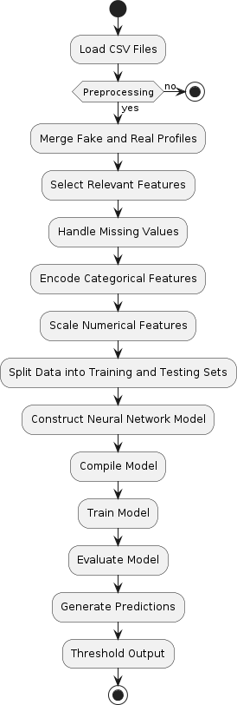
Flow Diagram

Slide 8
Dataset
The dataset that we utilized was obtained from MIB [17]. There were a total of 6825 profiles in the data set, with 3474–REAL and 3351-FAKE. The chosen data included ‘TFP and E13’ for REAL accounts and ‘INT, TWT and FSF’ for FAKE accounts. The information is saved in a CSV file format that the machine can easily read. All the markers on the x-axis represent the characteristics utilized in identifying the counterfeit profile. These were chosen
in the initial processing stage. The number of entries that each feature in the dataset has is represented on the y-axis.

Slide 9
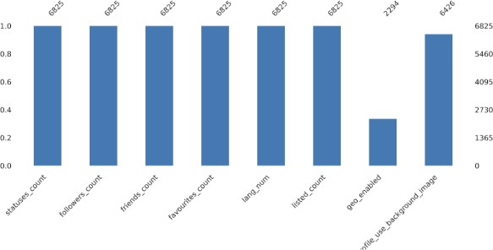
Dataset

Slide 10
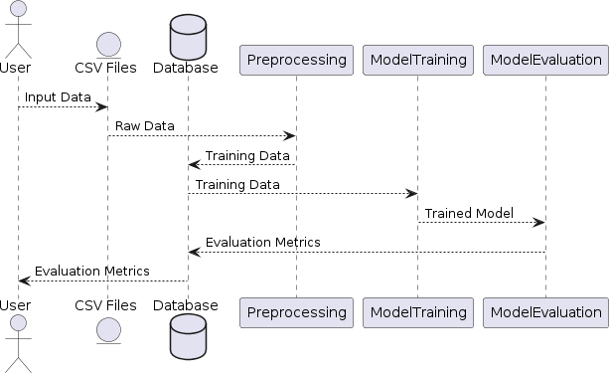
dfd

Slide 11
Models used
Random Forest: Random forest, or random-decision-forest, is a technique that belong to the group of ensemble learning techniques. This technique is utilized in machine learning is highly effective in solving regression problems because of its simplicity and efficiency. Accuracy : 99.25%
Extreme Gradient Boost: XG Boost is an additional ensemble learning approach employed for regression tasks. It enhances the stochastic gradient boosting technique. Accuracy : 99.46%
ADA Boost: AdaBoost, short for Adaptive Boosting, is a machine learning algorithm that combines multiple weak classifiers to form a strong classifier. It iteratively trains weak classifiers, giving more weight to misclassified instances, thereby improving overall performance. Accuracy : 99.13%
Decision Tree: A Decision Tree Classifier is a supervised machine learning model used for classification tasks. It constructs a tree-like model of decisions based on attribute values, where each leaf node represents a class label. Accuracy : 99.38%

Slide 12
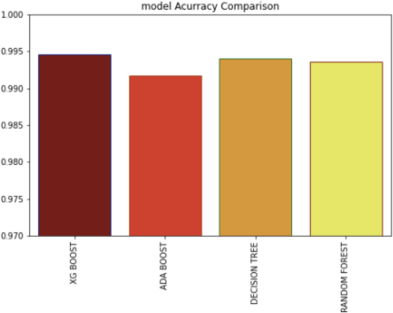
Accuracy of different Models

Slide 13
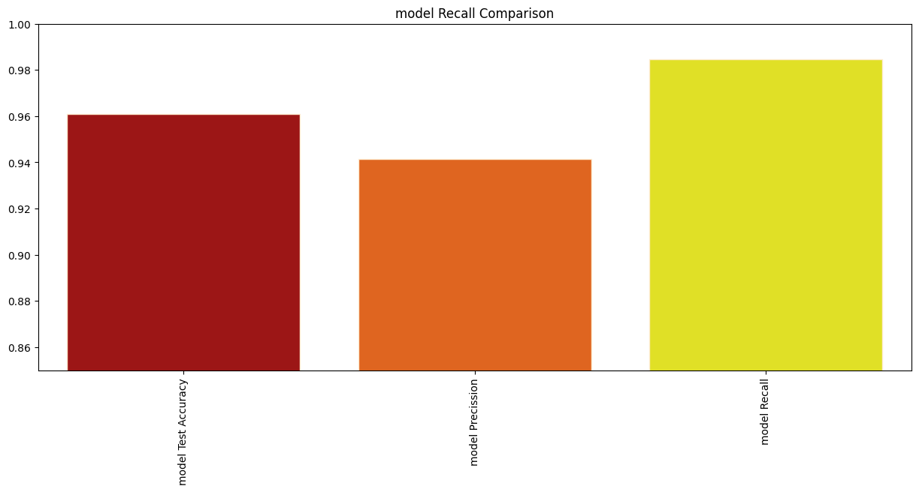
Model recall comparison

Slide 14
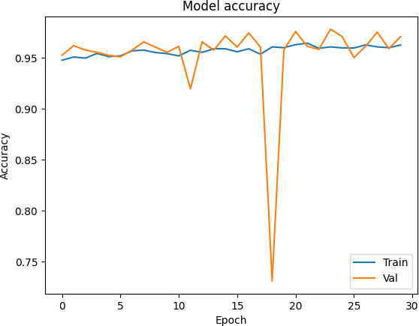
Model accuracy

Slide 15
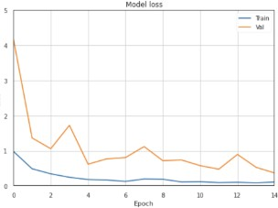
Model loss

Slide 16
Future prospects
Integration of Advanced Neural Network Architectures:
Further explore the potential of advanced neural network architectures such as Fully Connected Neural Networks (FNN), Convolutional Neural Networks (CNN), and Long Short-Term Memory Networks (LSTM) for detecting fake social media profiles on Twitter.
Investigate techniques to optimize these architectures specifically for social media data, enhancing their ability to capture nuanced patterns indicative of fake profiles.
Hyperparameter Tuning and Optimization for FNN, CNN, and LSTM:
Conduct extensive hyperparameter tuning and optimization for FNN, CNN, and LSTM models to maximize their performance in fake profile detection.
Experiment with different configurations of layers, neurons, activation functions, and learning rates to fine-tune the models for optimal accuracy and efficiency.
Deployment Strategies for Real-time Monitoring:
Develop robust deployment strategies to integrate FNN, CNN, and LSTM models into a real-time monitoring system for Twitter profiles.
Implement mechanisms for continuous monitoring and updating of models to adapt to evolving patterns of fake profile behavior, ensuring timely detection and mitigation.

Slide 17
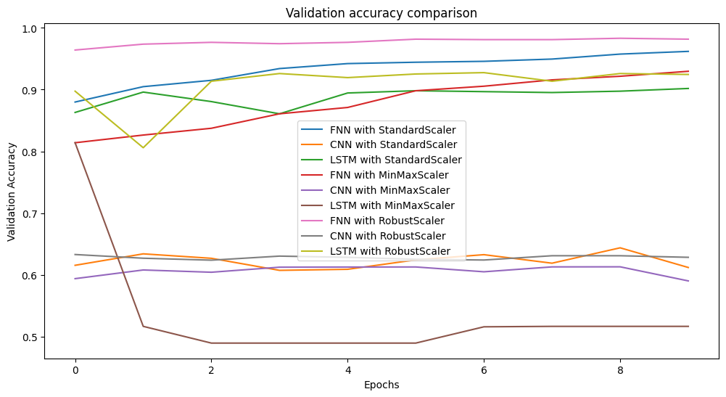
Validation accuracy comparison

Slide 18
Conclusion
In-this model, we incorporated the Neural-Network, Random-Forest, and XGBoost. Enhance machine-learning techniques for training ‘our system’ to identify fake-Twitter profiles, documents created from data that can be seen. Once we trained, validated, and tested our models on. After analysing the MIB data set, we ultimately deduce that the highest level of accuracy is achieved by XG Boost method reached a success rate of 99.46%, with ANN and random forest closely behind. More progress can be made by merging images of side views with the cat-egorical. Use both categorical and numerical data and apply it with a CNN. In addition, incorporating additional items as well. We have combine parameters from various models, and build a live model to attain improved outcomes.

Slide 19
Thank You

